Slide 1

Slide 1
Azure Sentinel Hackathon
Creating digital tripwires with custom threat intelligence feeds for Azure Sentinel

Slide 2
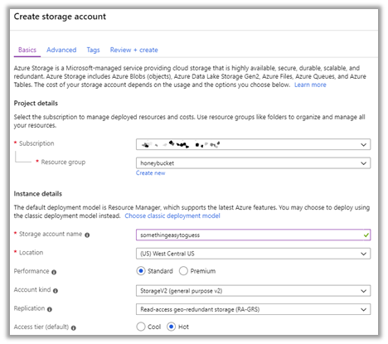
Slide 1
1.Create your bucket

Slide 3
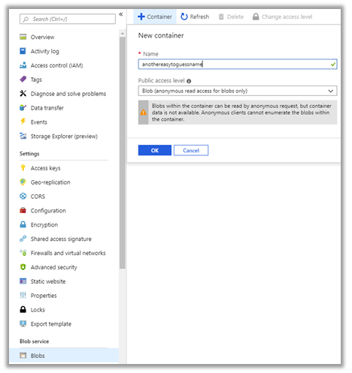
Slide 2
2. Create container Change permissions folders

Slide 4
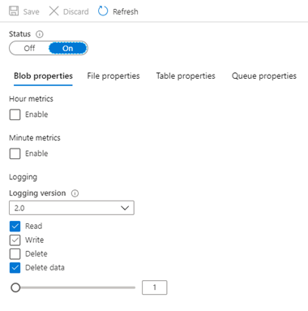
Slide 3
3. Enable debug logging

Slide 5
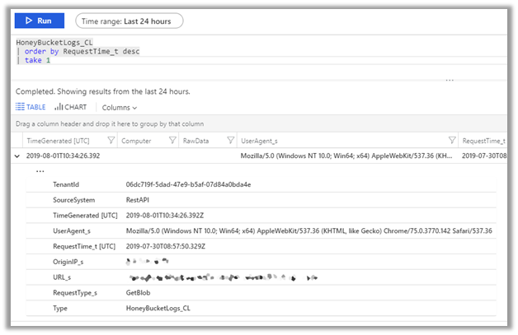
Slide 4
4. Scan your device for threats
Windows Defender Antivirus automatically scans your device for threats, and you can perform additional scans whenever you want.

Slide 6
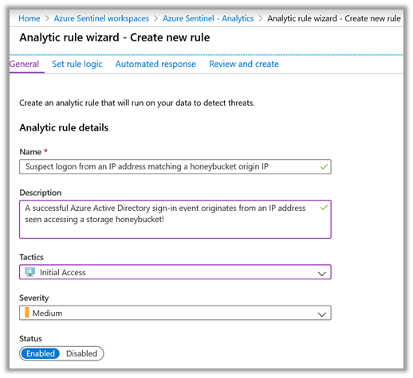
Slide 4
5. Threat hunting with Azure Sentinel

Slide 7
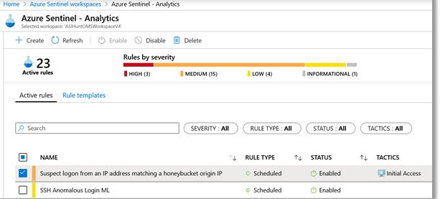
Slide 4
6. Analytic rule wizard

